Slide 1
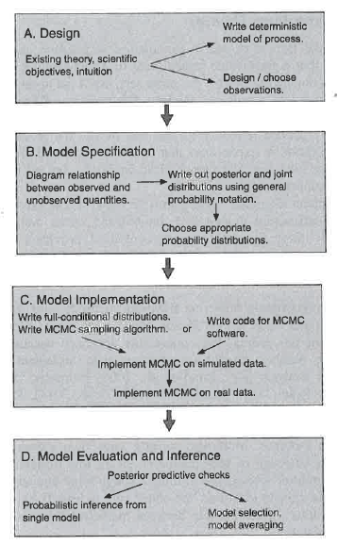
Hobbs & Hooten (2015)

Slide 2
Motivation
Why Bayes?
Scientific models are, above all else, abstractions
However, because models are abstractions and reduce the dimensions of a problem, we must deal with the elements we choose to omit
so it follows that assessing uncertainty is fundamental to science
Why hierarchical models?
Why are these useful in ecology?
Allow us to decompose complex, high dimensional problems into parts that can be thought about and analysed individually
Broad and flexible approach, allowing us to tackle virtually any ecological problem

Slide 3
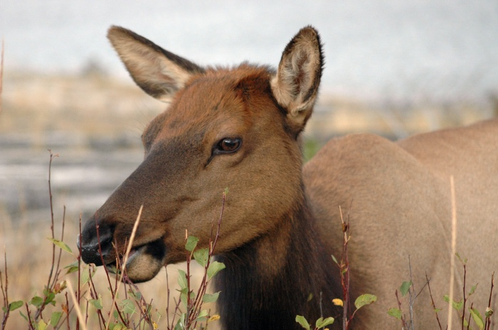
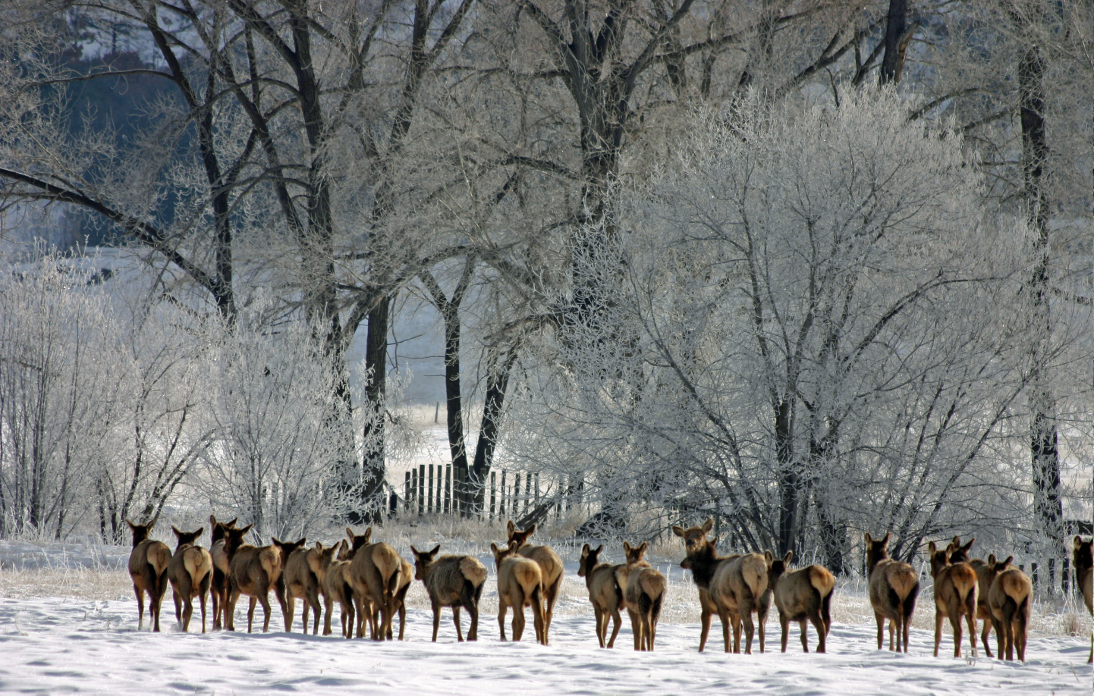
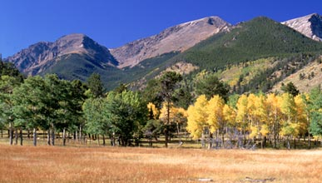
Ecological variation – levels of biological organisation
Spatial and temporal heterogeneity
Scale
Fragmentation
Individuals
Populations
Communities and Ecosystems

Slide 4
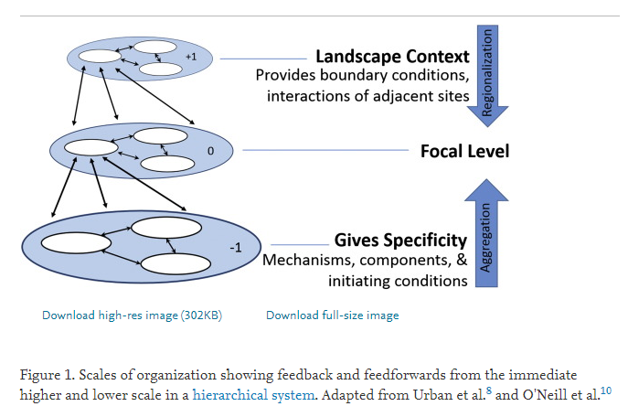
Ecological variation – spatial scales
Landscape
Habitat type
Plots
Individual plants
Adapted from Salley et al. 2016. Rangelands 38(6):313—317 doi: 10.1016/j.rala.2016.10.003

Slide 5
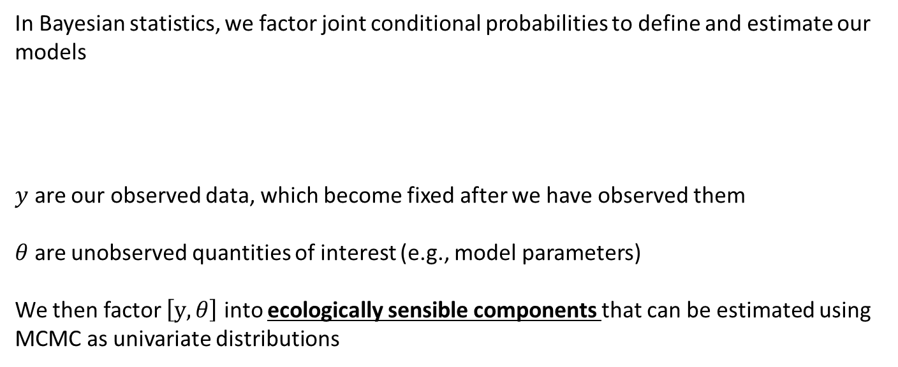
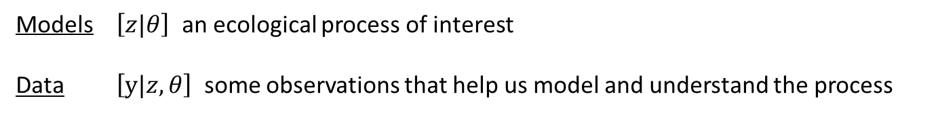
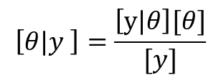
Our line of inference…
Models $\left[z|θ\right]$ an ecological process of interest
Data $\left[y|z,θ\right]$ some observations that help us model and understand the process
In Bayesian statistics, we factor joint conditional probabilities to define and estimate our models
$y$ are our observed data, which become fixed after we have observed them
$θ$ are unobserved quantities of interest (e.g., model parameters)
We then factor $\left[y,θ\right]$ into ecologically sensible components that can be estimated using MCMC as univariate distributions
$$\left[θ|y \right]=\frac{\left[y|θ\right][θ]}{[y]}$$

Slide 6
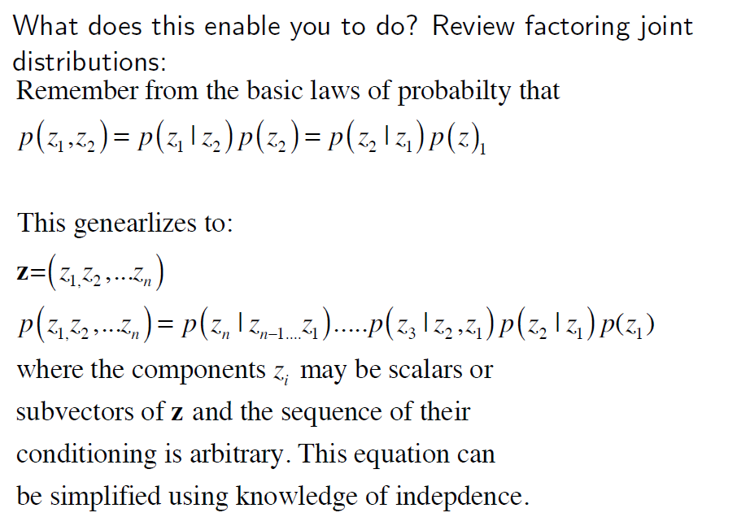
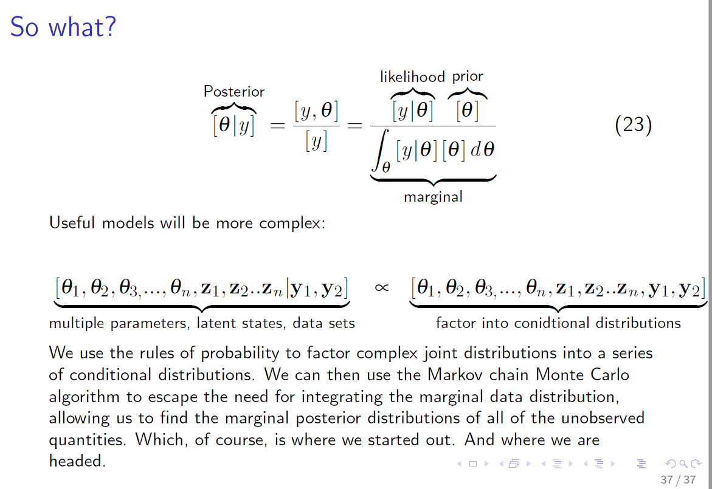
What does this enable us to do?
Factoring joint distributions allows us to decompose complex, high dimensional problems into parts that can be thought about and analysed individually
The sequence of conditioning is arbitrary, when we build models we choose a sequence that makes sense
Useful, ecological models will be more complex…
And we use MCMC to find the marginal posterior distributions of all the unobserved quantities
Multiple parameters, latent states, multiple datasets
Factor into conditional distributions

Slide 7
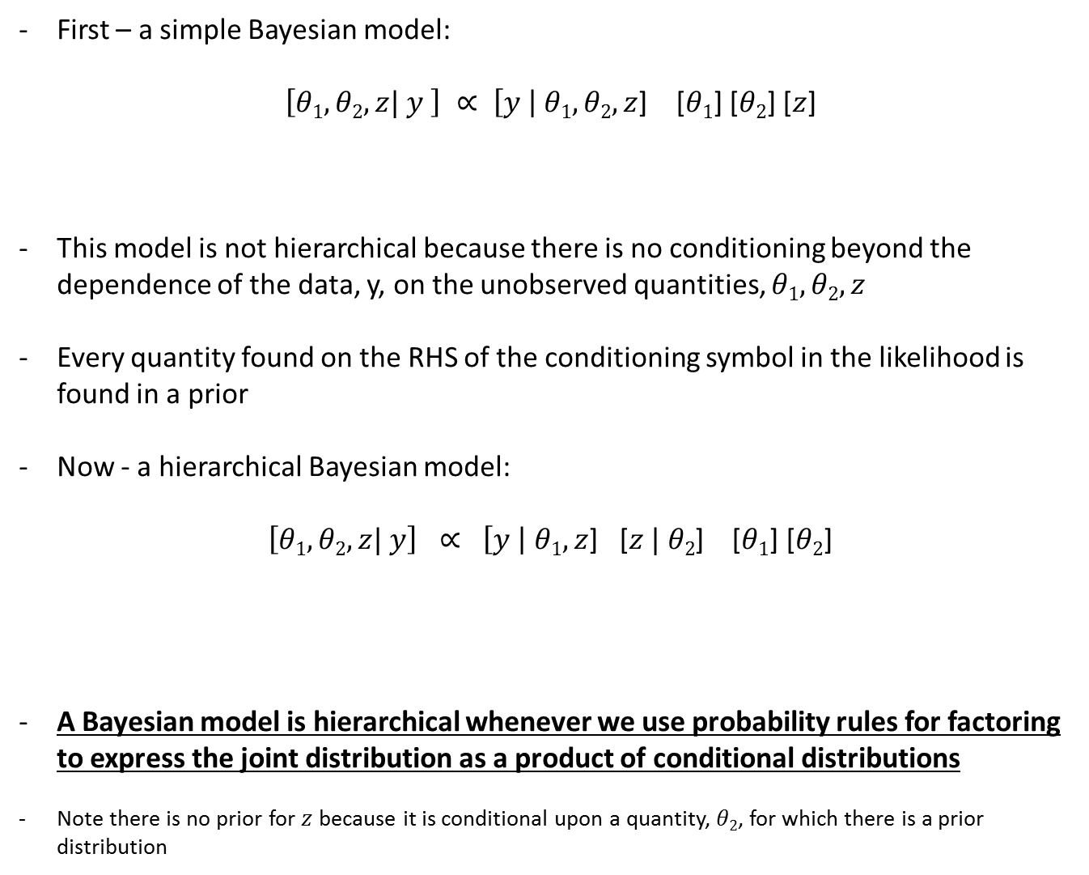
First – a simple Bayesian model:
$\left[θ1,θ2,z| y \right] ∝ \left[y \right| θ1,θ2,z$] [$θ1$] [$θ2$] [$z$]
This model is not hierarchical because there is no conditioning beyond the dependence of the data, y, on the unobserved quantities, $θ1,θ2,z$
Every quantity found on the RHS of the conditioning symbol in the likelihood is found in a prior
Now - a hierarchical Bayesian model:
$\left[θ1,θ2,z| y\right] ∝ \left[y \right| θ1,z$] [$z | θ2$] [$θ1$] [$θ2$]
A Bayesian model is hierarchical whenever we use probability rules for factoring to express the joint distribution as a product of conditional distributions
Note there is no prior for $z$ because it is conditional upon a quantity, $θ2$, for which there is a prior distribution
Joint distribution
Posterior
unobserved
Likelihood
Priors
observed
Joint distribution
Posterior
unobserved
Likelihood (product of two conditional distributions)
Priors
observed

Slide 8
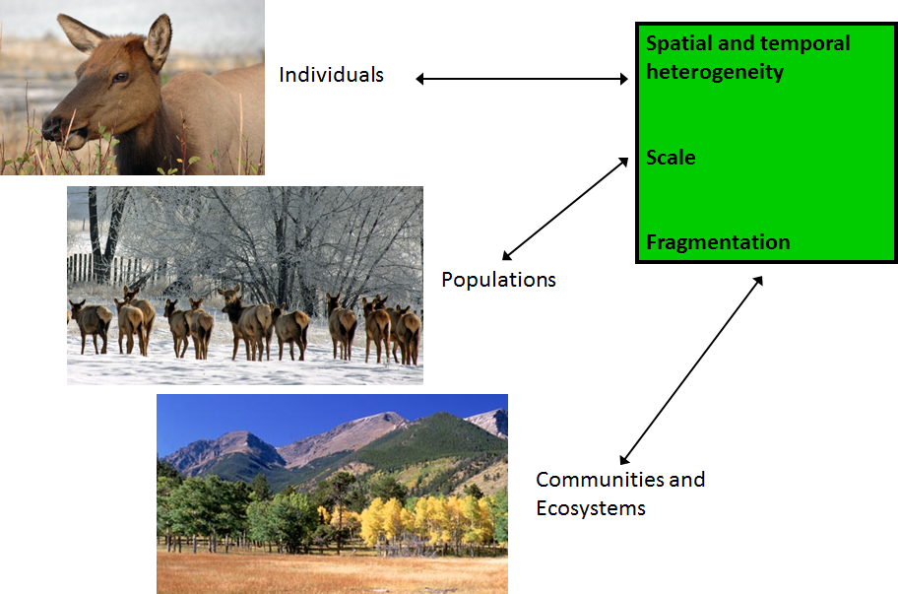
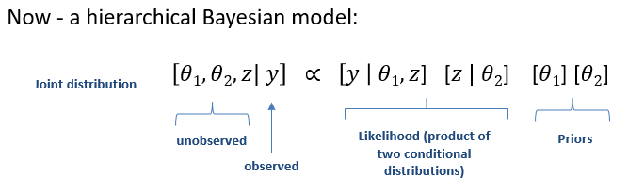
How does this help us with ecological models?
We use our knowledge of:
ecological systems (the context)
the ecological process
how we observe the process
the assumptions we make to simplify it
(represent it as a model)

Slide 9
Ecological research commonly has to deal with issues such as:
Variation among individuals (e.g., location or genotype)
Ecological processes operating at more than one spatial scale (plot → habitat type) or level of ecological organisation (individuals → populations → communities)
The need to accommodate uncertainty arising from modelling a process as well as uncertainty derived from imperfect observations
Dealing with changes in state that cannot be observed directly (age transitions of individuals that are hard to observe)

Slide 10
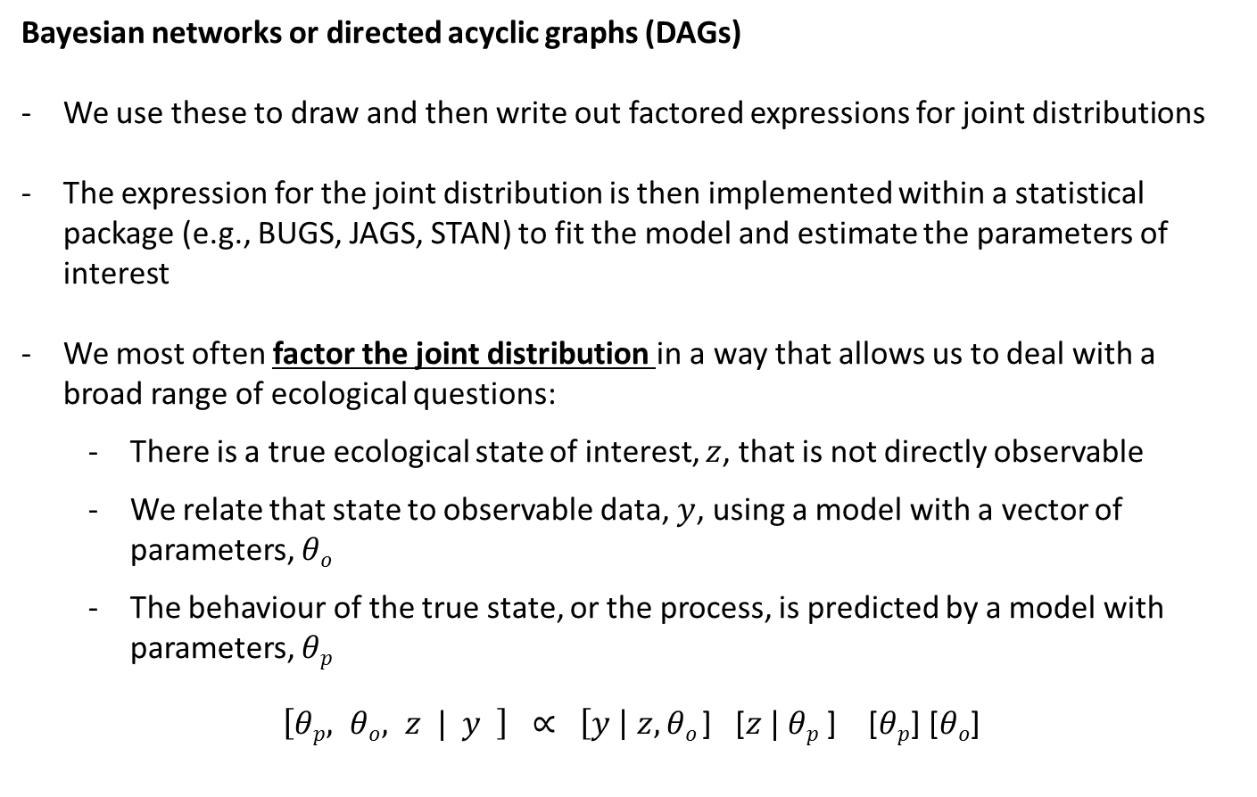
Bayesian networks or directed acyclic graphs (DAGs)
We use these to draw and then write out factored expressions for joint distributions
The expression for the joint distribution is then implemented within a statistical package (e.g., BUGS, JAGS, STAN) to fit the model and estimate the parameters of interest
We most often factor the joint distribution in a way that allows us to deal with a broad range of ecological questions:
There is a true ecological state of interest, $z$, that is not directly observable
We relate that state to observable data, $y$, using a model with a vector of parameters, $θo$
The behaviour of the true state, or the process, is predicted by a model with parameters, $θp$
$\left[θp, θo, z | y \right] ∝ \left[y \right| z,θo$] [$z | θp$ ] [$θp$] [$θo$]
unobserved
Data
Process
Priors
observed

Slide 11
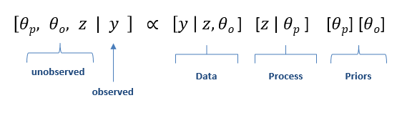
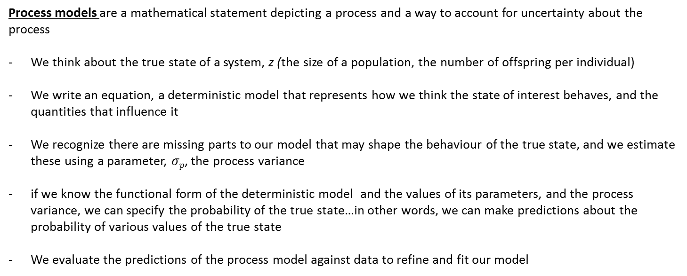
Process models are a mathematical statement depicting a process and a way to account for uncertainty about the process
We think about the true state of a system, z (the size of a population, the number of offspring per individual)
We write an equation, a deterministic model that represents how we think the state of interest behaves, and the quantities that influence it
We recognize there are missing parts to our model that may shape the behaviour of the true state, and we estimate these using a parameter, $σp$, the process variance
if we know the functional form of the deterministic model and the values of its parameters, and the process variance, we can specify the probability of the true state…in other words, we can make predictions about the probability of various values of the true state
We evaluate the predictions of the process model against data to refine and fit our model

Slide 12
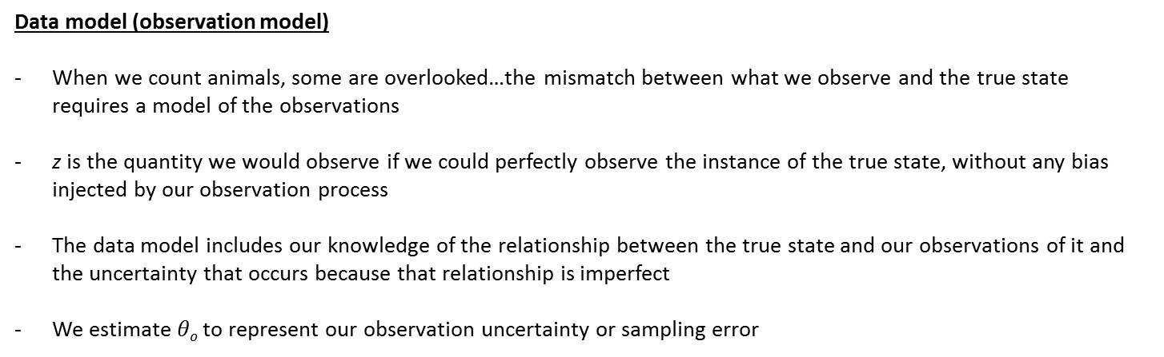
Data model (observation model)
When we count animals, some are overlooked…the mismatch between what we observe and the true state requires a model of the observations
z is the quantity we would observe if we could perfectly observe the instance of the true state, without any bias injected by our observation process
The data model includes our knowledge of the relationship between the true state and our observations of it and the uncertainty that occurs because that relationship is imperfect
We estimate $θo$to represent our observation uncertainty or sampling error
Parameter model (priors)
what we know about the parameters when we began our investigation, that is, our prior knowledge
Process model + data model + priors = full mathematical expression for our ecological process (process model), linked to data (data model), in a way that includes all sources of uncertainty (observation uncertainty and process uncertainty), and allows us to include prior understanding (priors)

Slide 13
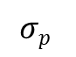
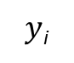
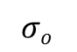
Bayesian networks or directed acyclic graphs (DAGs)
$y$_{i}
Data
z_{i}
Process
$$σo$$
$$σp$$
Parameters
$\left[θp, θo, z | y \right] ∝ \left[y \right| z,θo$] [$z | θp$ ] [$θp$] [$θo$]
unobserved
Data
Process
Priors
observed

Slide 14
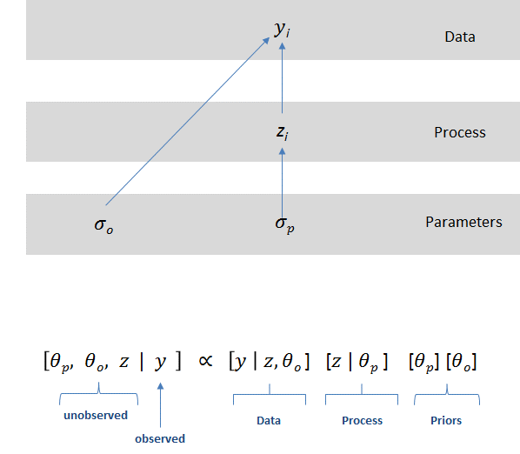
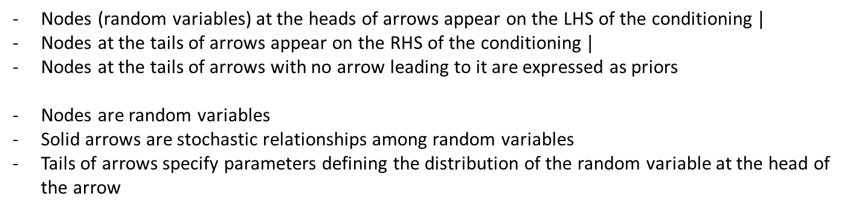
Nodes (random variables) at the heads of arrows appear on the LHS of the conditioning $|$
Nodes at the tails of arrows appear on the RHS of the conditioning $|$
Nodes at the tails of arrows with no arrow leading to it are expressed as priors
Nodes are random variables
Solid arrows are stochastic relationships among random variables
Tails of arrows specify parameters defining the distribution of the random variable at the head of the arrow

Slide 15
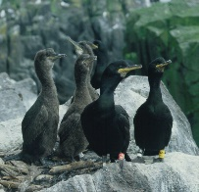
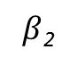
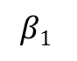
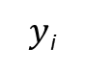
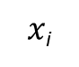
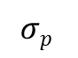
Let’s make this a bit less abstract….variation in processes caused
by variation among individuals
Length of shag partnership
$x$_{i}
$y$_{i}
Productivity of shags (can I detect the chicks in the nest?)
Data
z_{i}
Productivity of shags (actual)
Process
$$β1$$
$β$₂
$$σp$$
Parameters
regression parameter
regression parameter
Process uncertainty
$\left[σp, β1,β2, z | y \right] ∝ \left[y \right| z$] [$z |σp, β1, β2$] [$β$₁] [$β2$] [$σp$]
Data
Process
Priors

Slide 16
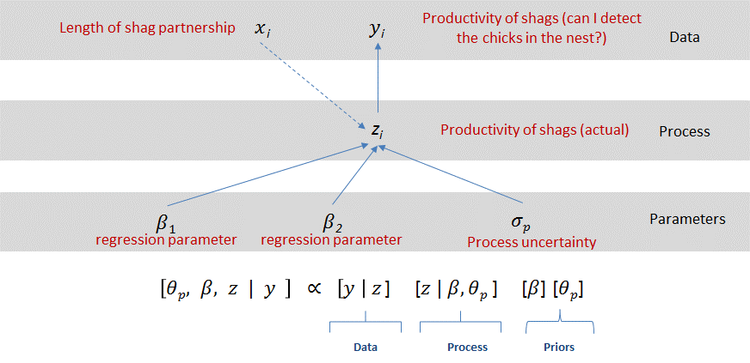
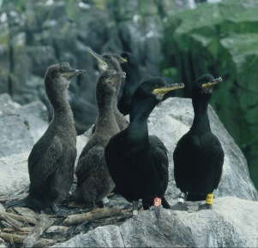
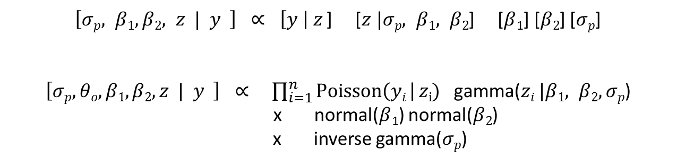
Assigning probability distributions to our random variables…
$\left[σp, β1,β2, z | y \right] ∝ \left[y \right| z$] [$z |σp, β1, β2$] [$β$₁] [$β2$] [$σp$]
$\left[σp, θo, β1,β2,z | y \right] ∝$ $\prod_{i=1}^{n}{Poisson\left(yi \right| zi)}$ $\text{gamma}\text{(}zi |β1, β2,σp\text{)}$
x normal($β$₁) normal($β2$)
x inverse gamma($σp$)

Slide 17
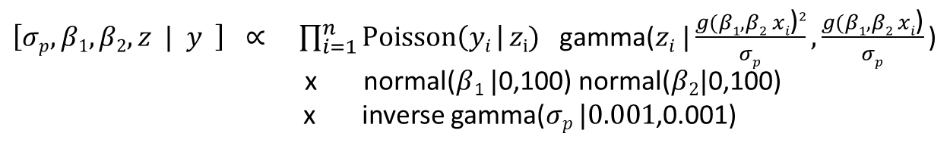
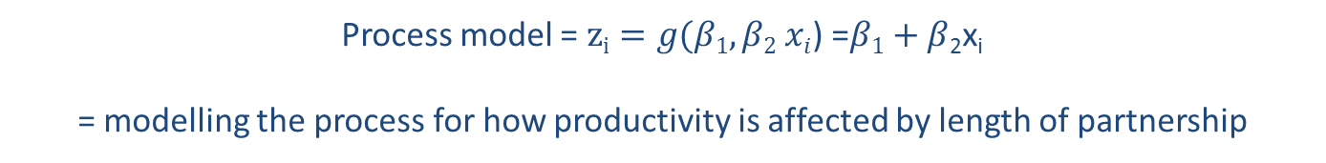
Adding in the process model for productivity…
Process model = $zi=g(β1,β2 xi$) =$β1+β$₂x_{i}
= modelling the process for how productivity is affected by length of partnership
$\left[σp, β1,β2,z | y \right] ∝$ $\prod_{i=1}^{n}{Poisson\left(yi \right| zi)}$ $\text{gamma}\text{(}zi |\frac{g(β1,β2 xi\text{)}2}{σp},\frac{g(β1,β2 xi\text{)}}{σp}\text{)}$
x normal($β$₁ $|$0,100) normal($β2|\text{0,100}$)
x inverse gamma($σp |0.001$,0.001)

Slide 18
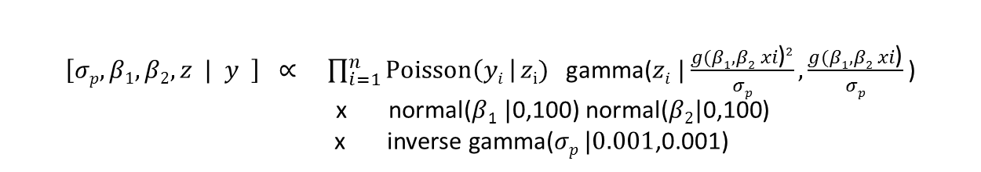

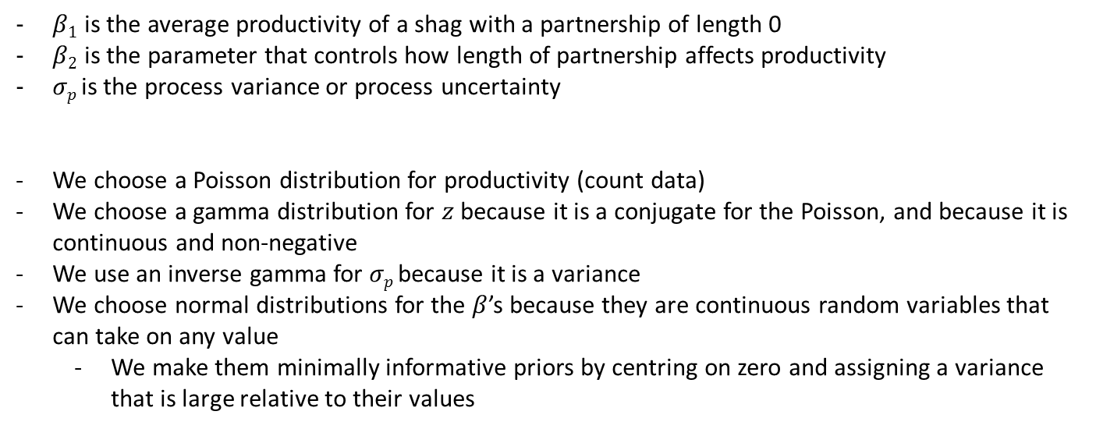
Process model = $zi=g(β1,β2 xi$) =$β1+β$₂x_{i}
= modelling the process for how productivity is affected by length of partnership
$\left[σp, β1,β2,z | y \right] ∝$ $\prod_{i=1}^{n}{Poisson\left(yi \right| zi)}$ $\text{gamma}\text{(}zi |\frac{g(β1,β2 xi\text{)}2}{σp},\frac{g(β1,β2 xi\text{)}}{σp}\text{)}$
x normal($β$₁ $|$0,100) normal($β2|\text{0,100}$)
x inverse gamma($σp |0.001$,0.001)
$β1$ is the average productivity of a shag with a partnership of length 0
$β2$ is the parameter that controls how length of partnership affects productivity
$σp$is the process variance or process uncertainty
We choose a Poisson distribution for productivity (count data)
We choose a gamma distribution for $z$ because it is a conjugate for the Poisson, and because it is continuous and non-negative
We use an inverse gamma for $σp$because it is a variance
We choose normal distributions for the $β$’s because they are continuous random variables that can take on any value
We make them minimally informative priors by centring on zero and assigning a variance that is large relative to their values

Slide 19
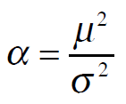
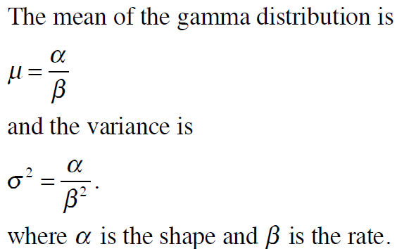
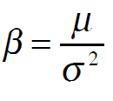
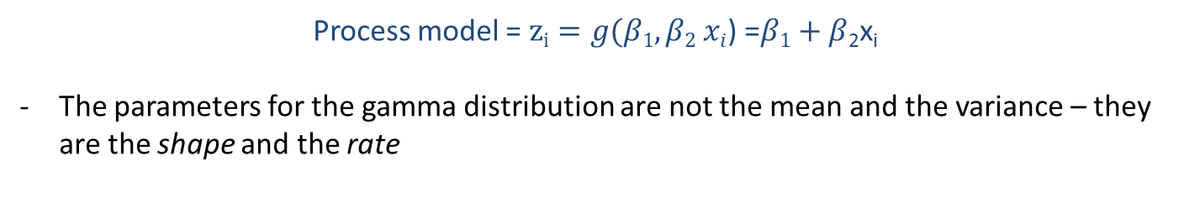
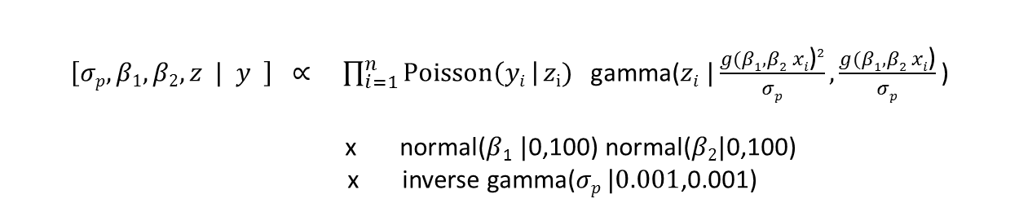
Moment matching…
$\left[σp, β1,β2,z | y \right] ∝$ $\prod_{i=1}^{n}{Poisson\left(yi \right| zi)}$ $\text{gamma}\text{(}zi |\frac{g(β1,β2 xi\text{)}2}{σp},\frac{g(β1,β2 xi\text{)}}{σp}\text{)}$
x normal($β$₁ $|$0,100) normal($β2|\text{0,100}$)
x inverse gamma($σp |0.001$,0.001)
What’s going on here?
Process model = $zi=g(β1,β2 xi$) =$β1+β$₂x_{i}
The parameters for the gamma distribution are not the mean and the variance – they are the shape and the rate

Slide 20
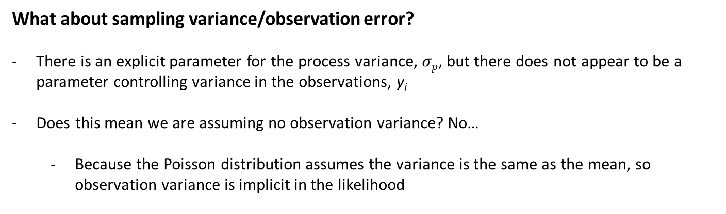
What about sampling variance/observation error?
There is an explicit parameter for the process variance, $σp$, but there does not appear to be a parameter controlling variance in the observations, y_{i}
Does this mean we are assuming no observation variance? No…
Because the Poisson distribution assumes the variance is the same as the mean, so observation variance is implicit in the likelihood

Slide 21
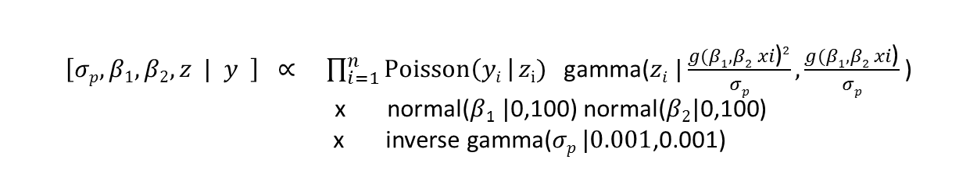
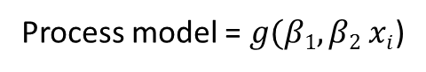
$\left[σp, β1,β2,z | y \right] ∝$ $\prod_{i=1}^{n}{Poisson\left(yi \right| zi)}$ $\text{gamma}\text{(}zi |\frac{g(β1,β2 xi\text{)}2}{σp},\frac{g(β1,β2 xi\text{)}}{σp}\text{)}$
x normal($β$₁ $|$0,100) normal($β2|\text{0,100}$)
x inverse gamma($σp |0.001$,0.001)
Why doesn’t the dataset, x (length of partnership), appear in the posterior distribution?
The x are not treated as random variables in this formulation – we assume the x data are perfectly observed and fixed, while the y data are random variables
This means the x are known, fixed quantities, treated no differently than a constant – they are not random variables and therefore should not appear in the expression for the posterior distribution, which by definition, is composed of random variables
The predictor variables do appear as arguments to the deterministic function for puffin productivity:
Process model = $g(β1,β2 xi$)

Slide 22
Why do we need to do this?
clear, transparent science
We need to be able to express the posterior distribution as a set of joint factored likelihoods in order to fit our models in any software package
E.g., JAGS – the ‘model statement’ in JAGS is the joint distribution for the posterior of your model…
$\left[σp, β1,β2,z | y \right] ∝$ $\prod_{i=1}^{n}{Poisson\left(yi \right| zi)}$ $\text{gamma}\text{(}zi |\frac{g(β1,β2 xi\text{)}2}{σp},\frac{g(β1,β2 xi\text{)}}{σp}\text{)}$
x normal($β$₁ $|$0,100) normal($β2|\text{0,100}$)
x inverse gamma($σp |0.001$,0.001)

Slide 23
DAG and factoring practice:
Diagramming joint and conditional probabilities…

Slide 24
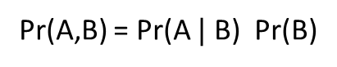
A
Pr(A,B) = Pr(A $|$ B) Pr(B)
B

Slide 25
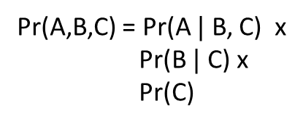
A
Pr(A,B,C) = Pr(A $|$ B, C) x
Pr(B $|$ C) x
Pr(C)
B
C

Slide 26
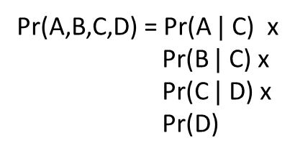
A
B
Pr(A,B,C,D) = Pr(A $|$ C) x
Pr(B $|$ C) x
Pr(C $|$ D) x
Pr(D)
C
D

Slide 27
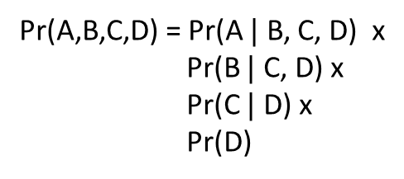
A
B
C
Pr(A,B,C,D) = Pr(A $|$ B, C, D) x
Pr(B $|$ C, D) x
Pr(C $|$ D) x
Pr(D)
D

Slide 28
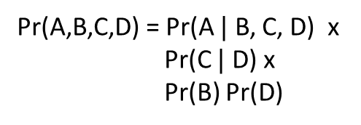
A
B
C
Pr(A,B,C,D) = Pr(A $|$ B, C, D) x
Pr(C $|$ D) x
Pr(B) Pr(D)
D

Slide 29
Add Pete’s model example

Slide 30
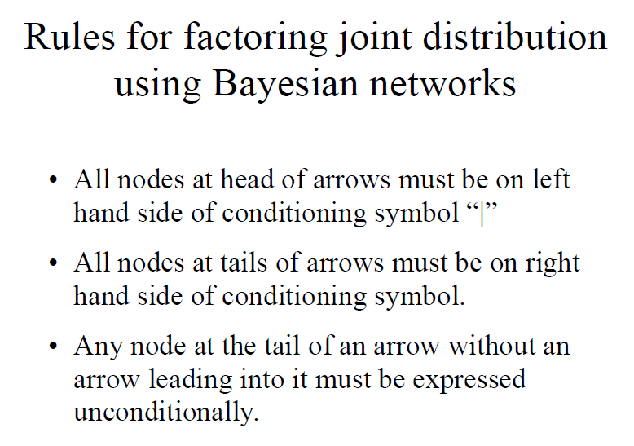

Slide 31
PRACTICAL

Slide 32
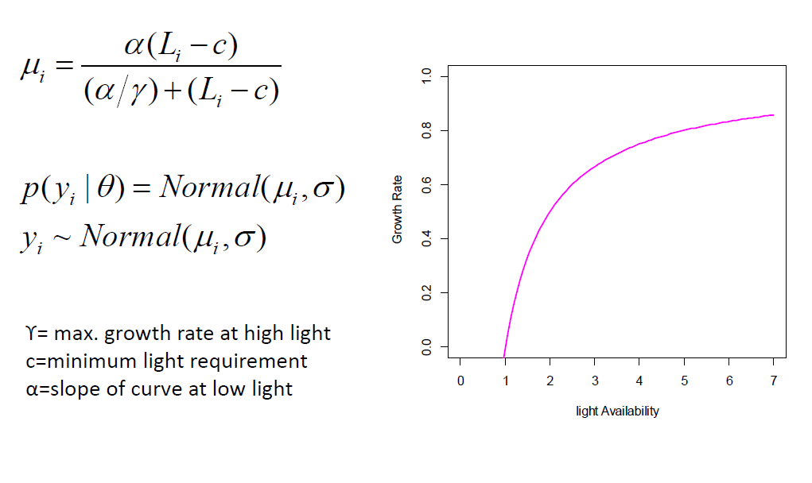


Exercise 1: Modelling light limitation of Hemlock tree growth
The relationship between tree growth rate and light tends to be non-linear, approaching an asymptote under high light conditions
Here, we model this simple curve using a Bayesian approach, where our response (y) is observed growth rate and our only predictor variable is light (L) = process model
Michealis-Menton equation
Process model = $g(α, γ, c,Li$) =
$α$ = max. growth at infinite light
$γ$ = rate at which curve tails off
$$c=light level at which growth is zero (x intercept)$$

Slide 33








Hierarchical Bayesian model…
Dotted line because we are assuming the covariate is known and fixed – it does not appear in the joint distribution for the posterior…
$L$_{i}
$y$_{i}
Data
$$μi$$
Process
Process uncertainty
Observation uncertainty
$$σo$$
$$α, γ, c$$
$$σp$$
Priors
$\left[α, γ, c,μi ,σp,σo| yi \right] ∝ \left[yi \right| μi,σo$]
x $\left[μi \right| g(α, γ, c),σp$]
x [$α$] [$γ$] [c] [$σp$] [$σo$]
Likelihood
unobserved
observed
Priors
Process model = $g(α, γ, c,Li$) = $μi=$

Slide 34
Fit hierarchical Bayesian model in R and JAGS…

Slide 35


Likelihood
Priors

Slide 36


Slide 37

Brief notes on model convergence…more later in the course

Slide 38

Trace plots provide an important tool for assessing mixing of a chain. Density plots are smoothed histograms of the samples, that is they show the function that we are trying to explore – the posterior density of our unobserved parameter…
Burn-in
It is standard practice to discard the initial iterations of iterative simulation as they are too strongly influenced by starting values and do not provide good information about the target distribution
n.eff
the effective sample size, that is an estimate for the number of independent samples (taking into account autocorrelations) generated by the MCMC run

Slide 39
Convergence
Our usual approach is, for each parameter or quantity of interest,
compute the variance of the simulations from each chain
average these within-chain variances = average within-chain variance
Then compare this to the variances of all the chains mixed together = mixture variance
We take the mixture variance divided by the average within-chain variance, compute the square root of this ratio, and call it R.hat or the “potential scale reduction factor” (Gelman and Rubin, 1992, following ideas of Fosdick, 1959).
At convergence, the chains will have mixed, so that the distribution of the simulations between and within chains will be identical, and the ratio R.hat should equal 1. If R.hat is greater than 1, this implies that the chains have not fully mixed and that further simulation might increase the precision of inferences.
In practice we typically go until R.hat is less than 1.1 for all parameters and quantities of interest
http://www.mcmchandbook.net/HandbookChapter6.pdf

Slide 40











Hierarchical Bayesian model…now with multiple sites, j
$Li$_{,j}
$yi$_{,j}
1
2
Data
3
$$μi,j$$
Process
$$σo$$
$$αj, γ, c$$
$$σp$$
Parameters
α₂
α₃
α₁
$$μα$$
$$σα$$
Hyper-parameters
Multiple sites, j, and we expect there to be differences in the maximum growth rate per site, α_{j}, for instance due to soil water availability
$\left[αj, γ, c, σp , μα, σα| yi,j \right] ∝ \left[yi,j \right| g(αj, γ, c),σp$]
$\left[αj \right| μα, σα$]
[$μα$] [$σα$] [$γ$] [c] [$σp$]
Process model = $g(α, γ, c,Li$) = $μi=$

Slide 41


Slide 43
END

Slide 44
EXTRA SLIDES

Slide 45


Slide 46


Slide 47


Slide 48


$\left[θp, β, z | y \right] ∝ \left[y \right| z$] [$z | β, θp$ ] [$β$] [$θp$]
$\left[θp, θo, β, z | y \right] ∝$ $\prod_{i=1}^{n}{binomial\left(yi \right| zi)}$
$\prod_{i=1}^{n}{\text{beta}\text{(}zi | β, θp\text{ )}}$
normal($β$)
inverse gamma($θp$)

Slide 49


Slide 50


Slide 51



Slide 52


